Slide 1

PRESENTATION ON “Voice Controlled AI Robotic Assistant For Physically Challenged and Elderly People”
Presented By:
Anup Jaiswal (2022031015)
Akansha Arya (2022031006)
Rishi Verma (2022031059)
Shambhavi (2022011153)
Ayush Kumar (2022031025)
Under the Supervision of :
Dr. Lal Bahadur Prashad
(Professor)
Electrical Engineering Department
Electrical Engineering Department
Madan Mohan Malaviya University of Technology,
Gorakhpur -273010 ,Uttar Pradesh,India (UP State Govt. University)

Slide 2
Content/ Outline
Introduction
Concept Design
System Specifications
Mechanical Design
Deep Learing and LLM Integration
Voice controlled and NLP (Natural Language Processing)
Circuit Design
Data Models and Communication Protocols
Result/Conclusion
Edge Computing
Modes of operation
Industrial Application and Future Scope
References

Slide 3
Introduction
“Voice Controlled AI Robotic Assistant” is an state of the art model, utilizing Deep Learning, LLM, and Natural Language Processing to simulate real human behaviour.
Its a 4 wheeled system, mounted with 4 axis robotic arm and a wireless camera module. (Earlier it was designed to be two wheeled self balacing, a trade off between project budget and advancements).
Our model represents an edge AI IoT system, which makes it secure and suitable for personal (like Personal Assistant) and organisational specific usecases (Like Plants, Factory, Hotels, Hospitals, Logistics etc).
Our project, represents the same idea and enables future possibilities. If implemented accordingly.

Slide 4
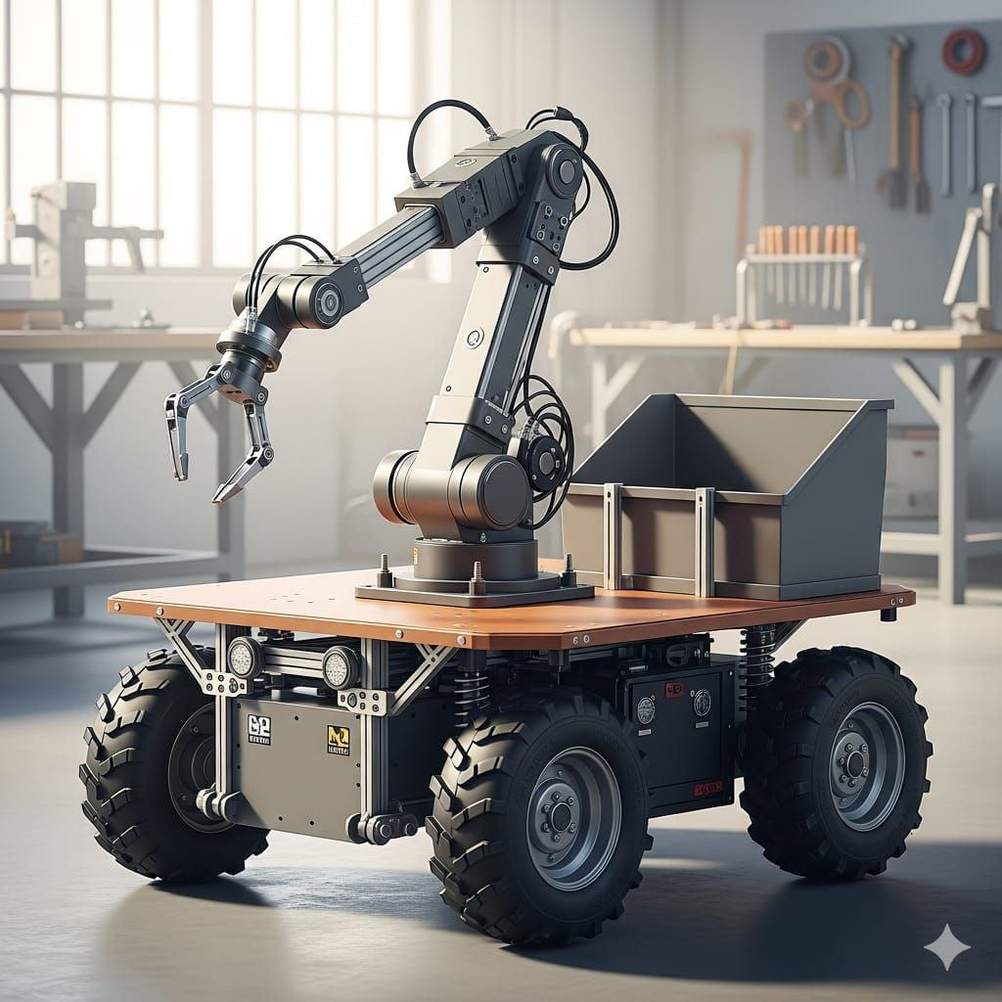
Concept Design
Idea > Imagination > AI > Concept Design
Idea was to utilise AI and Computer vision capabilities for analysis of surroundings and take corrective actions.
This model can assist, monitor, take actions as instructed.
Helpful to Physically Challenged peoples, to monitor them and present as 24x7 assistant.

Slide 5
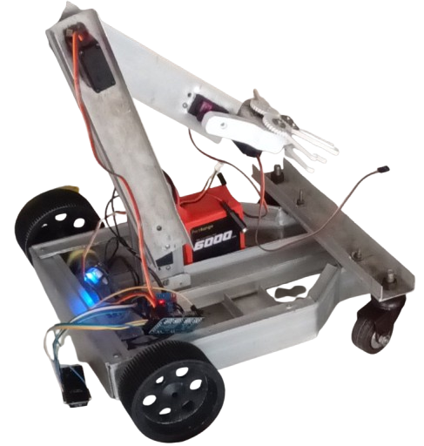
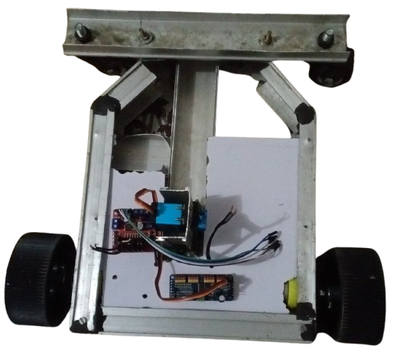
Concept Design

Slide 6
Components Used
1. ESP32 S3 Microcontroller Development Board
2. Pro-Range 7.4V 35 Kg cm DC Digital Servo Motor (OT5330M)
3. Pro-Range 25 Kg cm DC Digital Servo Motor (DS3225)
4. PCA9685 16 Channel 12 Bit Servo Driver
5. Pro-Range 11.1V 6000 mAH 3C 3S2P, 3 Cell Li-Ion Battery
6. TowerPro MG946R 10 Kg cm Digital Servo Motor
7. L298N DC Motor Driver
8. DC Gear Motor 12V 200RPM

Slide 7
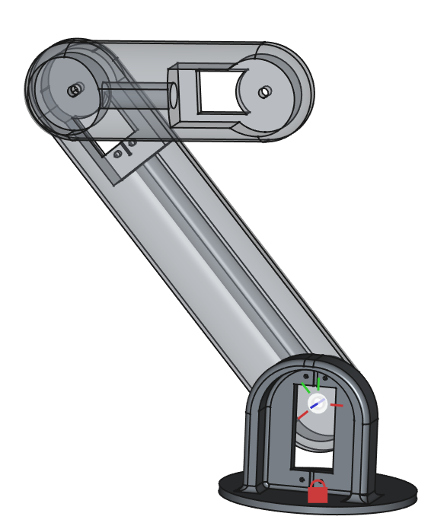
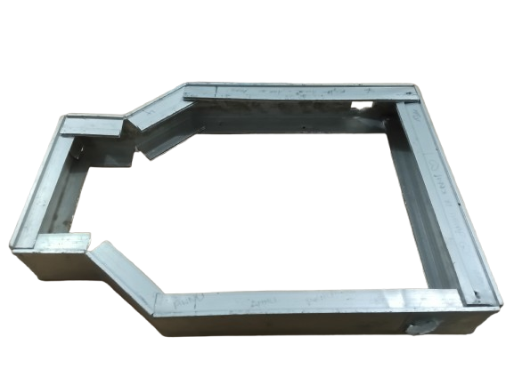
System Specifications
Mechanical Design :
We are using ‘freeCAD Open Source Software’ to design the mechanical structure.
In structural point of view, project is divided into two major parts :
Cart Body / Chasis (Physically ready) :
Used bracket shape aluminium strips to provide better load bearing capabilities
Interlocked jointed to ensure better rigidity and constrained dimensions
Robotic Arm :
designed completely in CAD model.
A 4 axis arm, fragmented into 5 parts

Slide 8
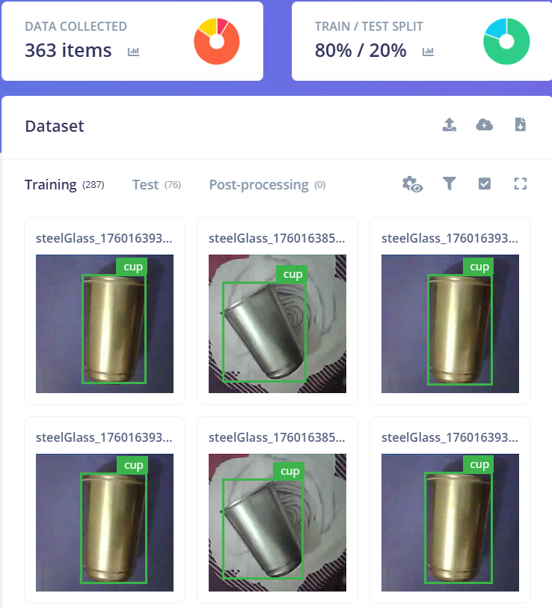
Deep Learning and LLM integration
FOMO (Fast Object, More Object) : A light weight Object detection model developed by edge impulse specifically for resource-constrained embedded devices (like MCU, ARM Cortex microcontroller s, ESP32 etc)
Custom trained with 2 real objects using Edge Impulse platform, used by ESP32 Wifi CAM module
Application in project :
FOMO object detection model is used in image classificaition, achieving upto 80-90% accuracy.

Slide 9

LLM Integration and NLP
Under the hood, at its central server (my Laptop, represented as Edge computing resources) uses Gemini LLM Api to process natural human voice nodes for intent analysis and command format generation, utilising Prompt Engineering Technique.
For now, command format includes 3 major tasks :
Searching
Navigating
Arm Operations

Slide 10
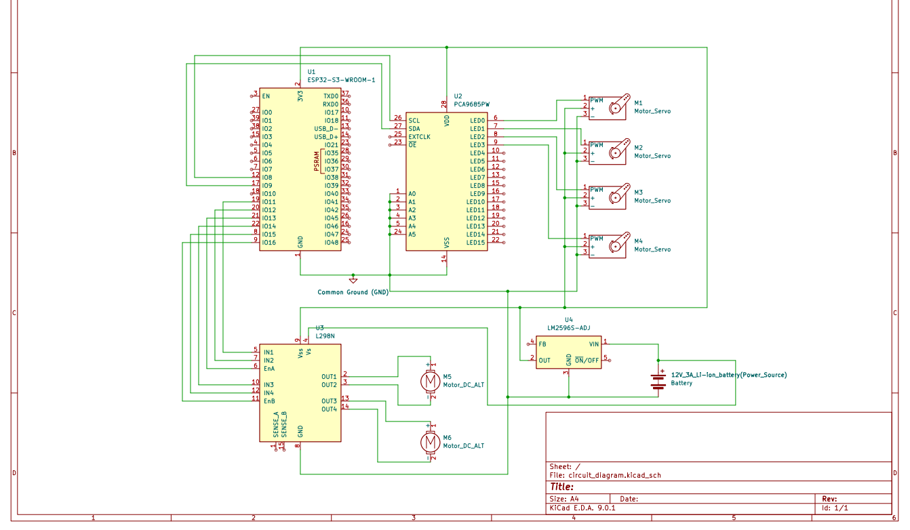
Circuit Design

Slide 11
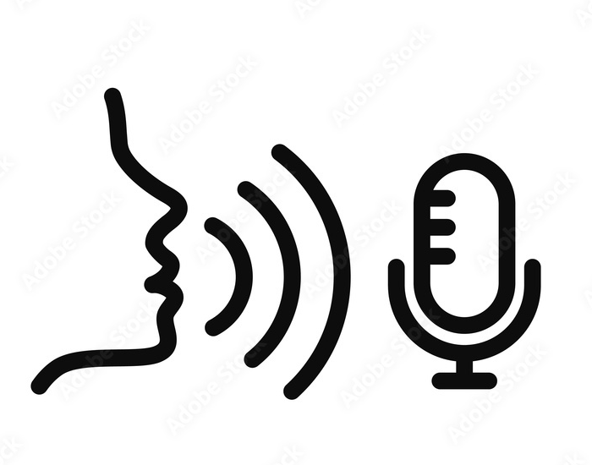
Data Models and Communication Protocols
React Web App :
1. Control Panel
2. Continous listening in low power mode
3. Outputs message from Robotic Assistant via speaker
Express Server (Laptop) :
1. MQTT Broker
2. Express.js Server
3. Gemini Api Integration
via HTTP
WebSockets
Voice Command
Central Server (The Edge )
User Application (Web App)
Robotic Model :
1. Object detection and classification using ESP32 CAM
2. 4 Axis Robotics Arm
3. DC geared motor as driver
via MQTT (PubSub Model) Protocol , two way persistent connection
Robotic Assistant (The Node)

Slide 12
Result / Conclusion
Project is realistic and achievable .
Its a custom designed project, that is every part is crafted and desinged from scratch.
Idea and Process can be implemented to broad level of application.
Utilises modern technologies like Deep learning, Computer vision and LLM integration.

Slide 13
Challenges Faced
1. Limited object detection
2. LLM integration
3. Limited working constraint
4. Limited vocal command dataset

Slide 14
References
https://grabcad.com/library/robotic-arm-420 [Sample Open soruce 3D CAD model ]
J. Williams and P. H. Chen, “Assistive robotics for independent living: A review of technological trends,” IEEE Transactions on Human-Machine Systems, vol. 49, no. 4, pp. 314–326, 2019.
https://www.coimbatronics.in/index.php?route=product/product&product_id=105
Y. Li and S. Hee, “Speech recognition challenges among elderly individuals: A systematic review,” Journal of Voice, vol. 35, no. 4, pp. 618–627, 2021.
S. Ghosh, P. K. Dutta, and S. Banerjee, “Deep learning-based speech-to-text system for assistive applications,” Procedia Computer Science, vol. 167, pp. 1971–1980, 2020.

